Slide 1
Smart Door Unlock
Faiz Ahmed & Mutasim Fuad Ansari

Slide 2
Motivation
Unlock a door from anywhere inside your apartment
Quick response
Ensure security
No Interruption in Meeting, Sleeping, Cooking, Online classes etc.

Slide 3
Architecture
Device 1
Door Switch
Gateway
Device 1
Device 1
Fig - 1: Door Switch clicked and Signal send to Gateway

Slide 4
Background
Based on Labs
Unicast:
Send ‘unlock’ signal to Gateway from door
Send ‘response’ signal from IoT device to Gateway
Broadcast:
Gateway forward the ‘unlock’ signal to IoT devices
Multihop disseminating and Multihop collection
Event Trigger (Button click) by Door lock and IoT Devices
Determining Door Address and Gateway Address

Slide 5
Background - Workflow
Device 1
Door Switch
Gateway
Device 1
Device 1
Fig - 1: Door Switch clicked and Signal send to Gateway

Slide 6
Background - Workflow
Device 1
Door Switch
Gateway
Device 1
Device 1
Fig - 2: Gateway Broadcasted the signal to Network

Slide 7
Background - Gateway
Device 1
Door Switch
Gateway
Device 1
Device 1
Fig - 3: All Devices got unlock signal

Slide 8
Background - Workflow
Device 1
Door Switch
Gateway
Device 1
Device 1
Fig - 4: Device1 responded to Gateway

Slide 9
Background - Workflow
Device 1
Door Switch
Gateway
Device 1
Device 1
Fig - 5: Gateway Forwarded the Unlock signal to Door Switch

Slide 10
Background - Workflow
Device 1
Door Switch
Gateway
Device 1
Device 1
Fig - 6: Door Unlocked

Slide 11
Goals
Use flooding to send signal from Main Door to Devices
Building Routing protocol and use unicast
Use Encryption to secure data

Slide 12
Results
Implemented the idea by not using Flooding
Building routing protocol is not appropriate for this project.
Used Unicast to send signal from Main Door to Gateway
Used Broadcast to send data from Gateway to IoT endpoints
Implemented Unicast for responding a signal from IoT endpoints
Tried to implement AES to ensure security but failed at the end

Slide 13
Approach
Used Contiki-NG OS version 4.5 to develop the project
Some C header files
Developed individual modules for
Main Door switch
Gateway
IoT Endpoints
Didn’t use actual IoT devices
Used Cooja Simulator for testing

Slide 14
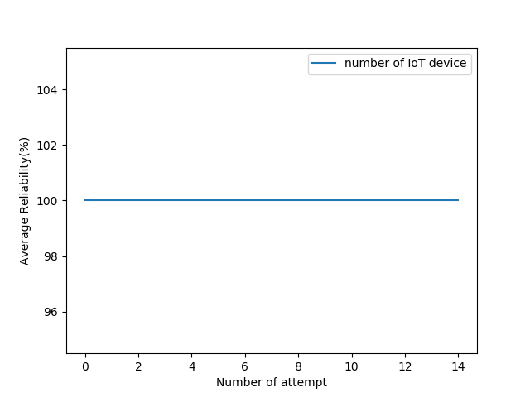
Evaluation - Reliability
There is no packet loss from Main Door Switch to IoT Endpoints

Slide 15
Evaluation - Latency
Maximum time taken by a signal from Main Door to IoT Endpoints.
According to the graph, the developed system is efficient

Slide 16
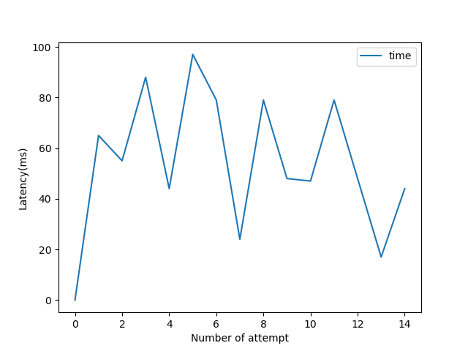
Evaluation - Latency

Slide 17
Evaluation - Invalid Signal
Without getting a signal from Main Door, IoT Endpoints are not allowed to send any response signal
If somebody already responded a Signal to unlock the door, responses from others will be ignored by Gateway

Slide 18
Evaluation - Resource consumption
Low battery consumption due to not using Flooding, Multihop Dissemination and Uninterrupted Infinity loop
Required low configured IoT Devices
Low cost

Slide 19
Lessons learned
How to develop a real IoT Project
Needed to start early implementation of the project.

Slide 20
Summary
Low cost
Easy to deploy

